Slide 1



LGPS and AVC Wise

Slide 2
Introduction
James Bolton
AVC Wise

Slide 3
Important Information
The information contained in this presentation is factual information only and does not constitute financial advice.
All case studies and examples used in this presentation represent typical situations and do not relate to any particular individuals or circumstances. All figures are for illustrative purposes only and are not guaranteed.
If you would like more information about your scheme, please contact your local pension scheme administrator.
Tax information is based on our understanding of current taxation, legislation and HM Revenue & Customs practice. All of these are liable to change without notice. The impact of taxation (and any tax saving) depends on individual circumstances.
You should consider your own individual circumstances, but if you are in any doubt you should consult a Financial Adviser for individual advice.

Slide 4
Focus for today
CLARITY
CHOICE
CONTROL

Slide 5

Clarity – The Local Government Pension Scheme
SECURITY
PEACE OF MIND
GENEROUS EMPLOYER CONTRIBUTIONS
EARLY AND FLEXIBLE RETIREMENT OPTIONS
SOME PROTECTION AGAINST THE EFFECTS OF INFLATION
EXCLUSIVE ADDITIONAL SAVING OPTIONS

Slide 6
Clarity – LGPS 2014
 | LGPS Before 1 April 2008
Basis of pension | Final Salary
Accrual rate | 1/80th
Contribution rate | 6%
Normal Pension age | 65
Early retirement | Employer consent was only required for early retirement before age 60. Possible reduction.
Automatic Tax-free cash | Yes
Ill health | At any age unreduced if the member was no longer capable of doing their old job or similar work. Possible enhancement based on length of service.
Maximum retirement age | 75
LGPS 1 April 2008 – 31 March 2014
Final Salary
1/60th
From 5.5% – 7.5%
65
Employer consent was only required for early retirement before age 60. Possible reduction.
No
At any age unreduced. Three levels of benefit available depending on the member's likelihood of being capable of working.
75
LGPS 1 April 2014
Career Average Revalued Earnings (CARE)
1/49th
From 5.5% – 12.5%
The higher of age 65 or SPA.
From age 55 – no employer consent required. Possible reduction.
No
At any age unreduced. Three levels of benefit depending on your likelihood for being capable of working in future.
75

Slide 7

How your benefits are calculated
Annual Pension
£397.12 each year
Tax-free lump sum
£1,118.41
Sarah
Retirement age: 67
Final Salary: £29,608
80th
1 year
All figures provided are for illustrative purposes only and are not guaranteed

Slide 8
How your benefits are calculated
Annual Pension
£3,176.94 each year
Tax-free lump sum
No automatic tax-free lump sum
Sarah
Retirement age: 67
Final Salary: £29,608
60th
6 years
All figures provided are for illustrative purposes only and are not guaranteed

Slide 9
How your benefits are calculated
Annual Pension
£11,346.24 each year
Tax-free lump sum
No automatic tax-free lump sum
Sarah
Retirement age: 67
Final Salary: £29,608
49th
18 years
This example uses a starting salary In the CARE scheme of £25,000 and assumes a 1% increase each year.
It also assumes CARE benefits have been revalued each year for inflation at 1.5%.
All figures provided are for illustrative purposes only and are not guaranteed.

Slide 10
How benefits are calculated if Sarah retires at 67
Annual Pension
£397.12 each year
Annual Pension
£3,176.94 each year
Annual Pension
£11,346.24 each year
Sarah
Retirement age: 67
Final Salary: £29,608
Annual Pension: £14,920.30
Tax-free lump sum: £1,118.41
1 year
6 years
18 years
This example uses a starting salary In the CARE scheme of £25,000 and assumes a 1% increase each year.
It also assumes CARE benefits have been revalued each year for inflation at 1.5%.
All figures provided are for illustrative purposes only and are not guaranteed.

Slide 11

Sarah wants to retire early at 64
£14,920.30
£1,118.41 tax-free lump sum
Income gap
£4,076.86
Expected benefits
Reduction
Sarah retires
age 64
Benefits
£10,843.44
£1,046.39 tax-free lump sum
Actual benefits
Reduced as taking early
Now
64
67
Pensionable Service
All actual benefits are reduced as taking early
All figures provided are for illustrative purposes only and are not guaranteed

Slide 12
Focus for today
CLARITY
CHOICE
CONTROL

Slide 13
Choice – Approved options within LGPS
 | Additional Pension Contributions (APCs)
Contributions | Fixed monthly amount. Scheme limits on the amount of additional pension that can be bought.
Term | Fixed – number of years agreed at outset.
Benefits | Fixed – and provides some protection against the effects of inflation.
More information available from | The Pension Scheme administrator or website.
Depending on your circumstances, APCs may meet your needs as well as AVCs. Should you wish to find out more about APCs, you need to talk to your Pension Fund administrator.

Slide 14
Choice – Approved options within LGPS
Contributions
Term
Benefits
More information available from
Additional Voluntary Contributions (AVCs)
Flexible contributions Limit to contributions that benefit from tax savings and possible tax charges apply where certain annual/lifetime limits exceeded
Flexible – stop and start contributions. If contributions stop, charges will still be deducted
Flexible – additional pension, an annuity from outside the LGPS, tax-free cash or a mixture
Your Local Government AVC provider
As AVCs are investment based, the value of investments can fall as well as rise and, depending on where you invest, you may not get back all of your investment. Depending on your circumstances, APCs may meet your needs as well as AVCs. Should you wish to find out more about APCs, you need to talk to your Pension Fund administrator.

Slide 15

Overview of AVC options?
A standard AVC that provides tax relief.
A new AVC facility called 'AVC Wise' that provides tax relief and national insurance savings.
AVC Wise is a Shared Cost AVC (SCAVC) facility and is provided through the use of a salary sacrifice arrangement.

Slide 16

How does AVC Wise work?
The Council will contribute all but £1 of your contribution amount.
In return, you will agree to accept a reduction in your salary which is equal to the contribution amount from the Council.
You agree to pay £1 per month as your contribution to the shared cost arrangement.
Salary sacrifice is a legitimate method used by employers to provide employee benefits.

Slide 17
Overview of AVC Wise options
The main advantage is that you do not pay tax or National Insurance Contributions (NICs) on the amount you have sacrificed.
It provides an opportunity to pay AVCs in a cost-effective way.
It results in an increase in take-home pay when compared to paying AVCs in the standard way.
It delivers your employer NIC savings too.

Slide 18

Joe
Salary: £30,000
Regular AVC: £250 per month (£3,000 each year)
 | Without AVC | With Standard AVC | With AVC Wise
Gross monthly pay (before main scheme contributions) | £2,500 | £2,500 | £2,251
Joe’s LGPS contribution | £162.50 | £162.50 | £162.50
Joe’s AVC contribution | £0 | £250 | £1
Employer AVC contribution | £0 | n/a | £249
Total AVC contribution | n/a | £250 | £250
Joe’s Income Tax | £275.83 | £225.83 | £225.83
Joe’s National Insurance | £218.36 | £218.36 | £188.48
Joe’s monthly pay after tax | £1,843.31 | £1,643.31 | £1,673.19
All figures provided are for illustrative purposes only and are not guaranteed.

Slide 19
Joe
Salary: £30,000
Regular AVC: £250 per month (£3,000 each year)
 | Without AVC | With Standard AVC | With AVC Wise
Gross monthly pay (before main scheme contributions) | £2,500 | £2,500 | £2,251
Joe’s LGPS contribution | £162.50 | £162.50 | £162.50
Joe’s AVC contribution | £0 | £250 | £1
Employer AVC contribution | £0 | n/a | £249
Total AVC contribution | n/a | £250 | £250
Joe’s Income Tax | £275.83 | £225.83 | £225.83
Joe’s National Insurance | £218.36 | £218.36 | £188.48
Joe’s monthly pay after tax | £1,843.31 | £1,643.31 | £1,673.19
All figures provided are for illustrative purposes only and are not guaranteed.

Slide 20
Joe
Salary: £30,000
Regular AVC: £250 per month (£3,000 each year)
 | Without AVC | With Standard AVC | With AVC Wise
Gross monthly pay (before main scheme contributions) | £2,500 | £2,500 | £2,251
Joe’s LGPS contribution | £162.50 | £162.50 | £162.50
Joe’s AVC contribution | £0 | £250 | £1
Employer AVC contribution | £0 | n/a | £249
Total AVC contribution | n/a | £250 | £250
Joe’s Income Tax | £275.83 | £225.83 | £225.83
Joe’s National Insurance | £218.36 | £218.36 | £188.48
Joe’s monthly pay after tax | £1,843.31 | £1,643.31 | £1,673.19
All figures provided are for illustrative purposes only and are not guaranteed.

Slide 21

Sarah wants to retire early at 64
Retires age 67
Retires age 64
£14,920.30
Income
£1,118.41
Tax-free
lump sum
£10,843.44
Income
£1,049.39
Tax-free
lump sum
Pre 1/4/14 benefits are enhanced
as taking after NPA
Post 1/4/14 benefits are not adjusted
All benefits are reduced as taking early
All figures provided are for illustrative purposes only and are not guaranteed.

Slide 22
Sarah wants to retire early at 64
She decides to pay SCAVCs at £250 a month for 12 years (£249 via salary sacrifice and £1 individual contribution)
Actual Cost to Sarah
NIC Saving
Tax Saving
Potential Growth (5%)
Sarah’s AVC pot
£24,497
£4,303
£7,200
£9,900
£45,900
We’ve based these figures on a basic rate taxpayer and can’t guarantee you’ll get this amount. If you’re paying tax in Scotland, your tax savings will be different. They are just examples from Prudential’s AVC calculator. We assume the example AC pot will grow at 5% each year and have an Annual Management Charge of 1%. Charges can change and we have taken inflation into account – it could mean your AVC pot could buy you less in the future. AVCs are investment based so the value can go down as well as up and you may get back less than you put in.

Slide 23
Basic Rate Taxpayer
The tax you pay depends on your individual circumstances. Tax rules may change in the future.

Slide 24
Basic Rate Taxpayer
The tax you pay depends on your individual circumstances. Tax rules may change in the future.

Slide 25









Choice – What you save
Retirement!
New home & marriage
Mortgage paid off
Promotion
Individuals Contributions
Pay rise
Baby
New Job!
Career break
Working life
This is a typical example and is not representative of any particular individual. Any payment changes will impact benefits at retirement

Slide 26

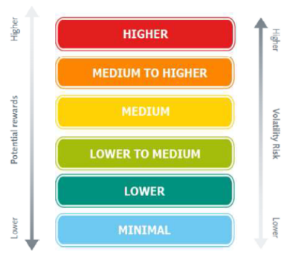


Choice – How you save
What does the fund invest in?
Risk Rating
Typically invests in:
Equities
Typically invests in:
Corporate Bonds,
Government Bonds (Gilts),
Multi-Asset, Property
Typically invests in:
Deposits,
Money Market Instruments
Funds selected by the pension fund
The above are not recommendations of any investment choice or fund. Your chosen pension fund(s) are investment based.

Slide 27




Flexible ways to take your money…..
From age 55, the options available under the LGPS include:
100% tax-free
lump sum
Tax-free lump sum and a guaranteed income for life
Tax-free lump sum and more LGPS benefits
You can choose a combination of the above options
Depending on your circumstances, you may need to transfer your AVC pot to another pension product in order to access some of these options
Pension Wise website: www.pensionwise.gov.uk
Pension Wise telephone number: 0800 138 3944

Slide 28

Flexible ways to take your money…..
From age 55, if you transfer your AVC pot to a new plan, you can:
Take a flexible retirement income
Take your pot as a number of lump sums (or a single lump sum)
Pension Wise website: www.pensionwise.gov.uk
Pension Wise telephone number: 0800 138 3944

Slide 29
Sarah age 64, retires early and defers her main scheme benefits
Potential to retire early and take partial withdrawals
Sarah’s AVC Wise pot
Pension Product
Transfer AVC pot to a different pension product
£45,900
£45,900
Figures have been rounded to three significant figures. All figures provided are for illustrative purposes only and are not guaranteed. Although Sarah’s pot remains invested in another pension product after transfer out, this examples assumes no rise or fall in the value each year.

Slide 30
Sarah age 64, retires early and defers her main scheme benefits
Potential to retire early and take partial withdrawals
25% tax-free lump sum
25% tax-free lump sum
25% tax-free lump sum
Pension Product
£45,900
LGPS benefits
No reduction
Age 64
£15,300
Age 65
£15,300
Age 66
£15,300
Withdraws
£12,905 income
Taxed as income
Taxed as income
Taxed as income
Age
64
67
Figures have been rounded to three significant figures. All figures provided are for illustrative purposes only and are not guaranteed. Although Sarah’s pot remains invested in another pension product after transfer out, this examples assumes no rise or fall in the value each year. Sarah’s LGPS benefits are revalued each year by CPI of 1.5% for each year she is a deferred member.

Slide 31
Retire with potentially more money – up to 100% tax-free lump sum
Sarah’s maximum tax-free lump sum potential = £71,243.21
Main scheme income:
£10,843.44
Automatic tax-free lump sum:
£1,046.39
Sarah
Retires early aged 64.
Takes scheme benefits.
LGPS Maximum Tax Free Cash = £71,243.21
All figures provided are for illustrative purposes only and are not guaranteed.
Calculation of potential tax-free lump sum is available in the appendix

Slide 32
Retire with potentially more money – up to 100% tax-free lump sum
Sarah’s AVC Pot = £45,900
This means she can take the full AVC pot within her tax-free lump sum
Sarah
Retires early aged 64.
Takes scheme benefits.
18 years
AVC tax-free lump sum: £45,900
All figures provided are for illustrative purposes only and are not guaranteed.

Slide 33
Conditions and considerations…
Main LGPS
National Minimum / Living Wage requirements
Lower Earnings Limit
Annual Allowance
Changing the contribution amount
Opting out or leaving employment
Aggregation of standard AVC plan to new SCAVC plan

Slide 34
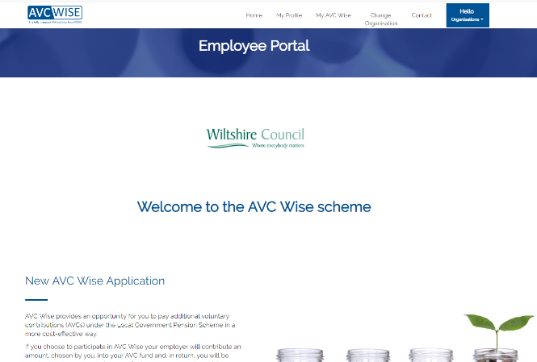
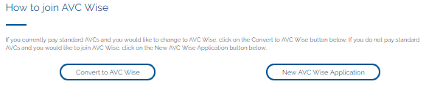
How to apply…
Log in to your organisation’s portal
Click to make a new application or convert to AVC Wise
Complete the info needed including your personal details and desired contribution amount

