Slide 1
VIP Conversation Toolkit
The aim of this toolkit is to share with you some tools that may support your VIP conversations around:
Change
Uncertainty
Resilience
Wellbeing
Notes:
You don’t need to use all the tools, just the ones you feel may be helpful to support your conversations
Pick out the tools that could best support your conversation, the individual, the circumstances or concerns
They may relate to both strengths and areas for support/development

Slide 2
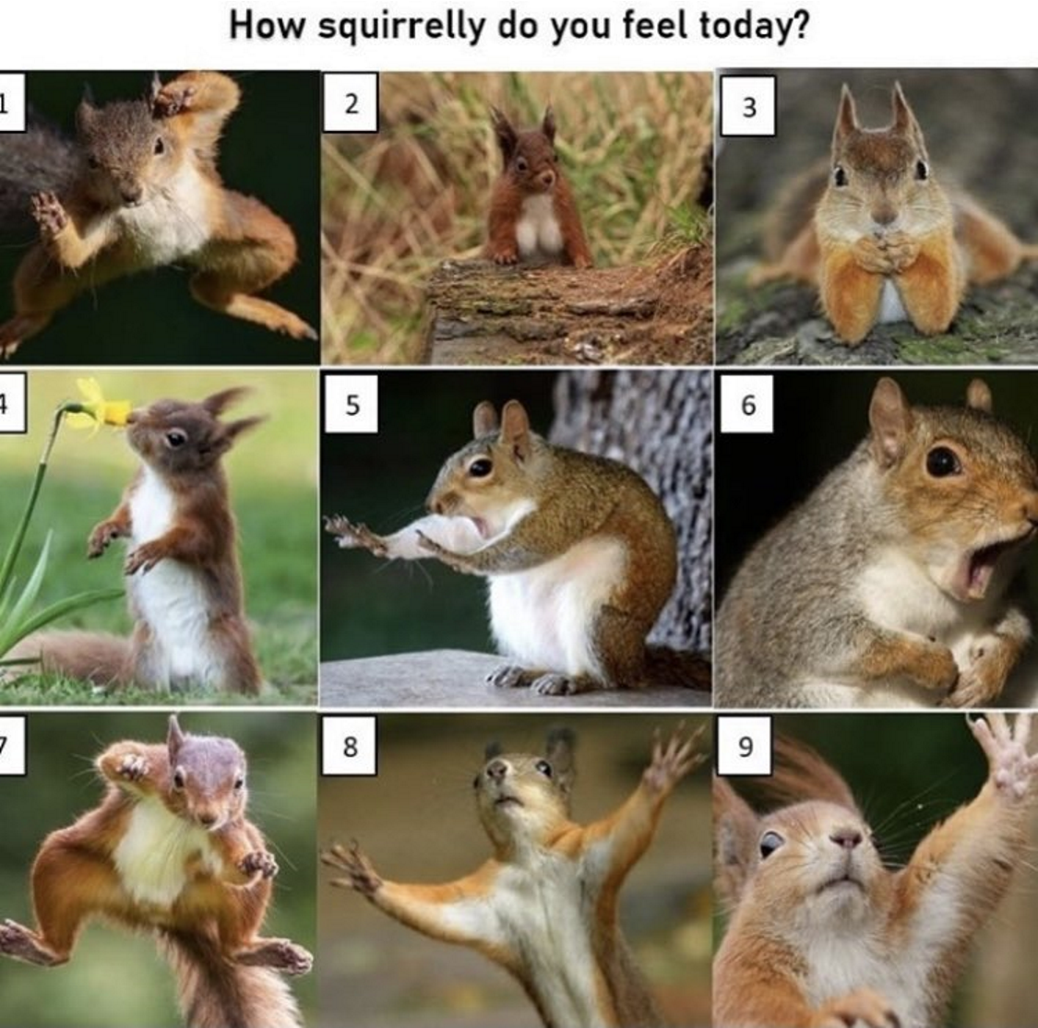
Notes:
Use as a conversation starter to explore how someone is feeling in general, today, right now or looking ahead.
Instead of asking how are you feeling, maybe share the picture and ask- How squirrelly are you feeling?
All the images are open to interpretation, Which squirrel would you like to be? What support do you need to be that squirrel?

Slide 3
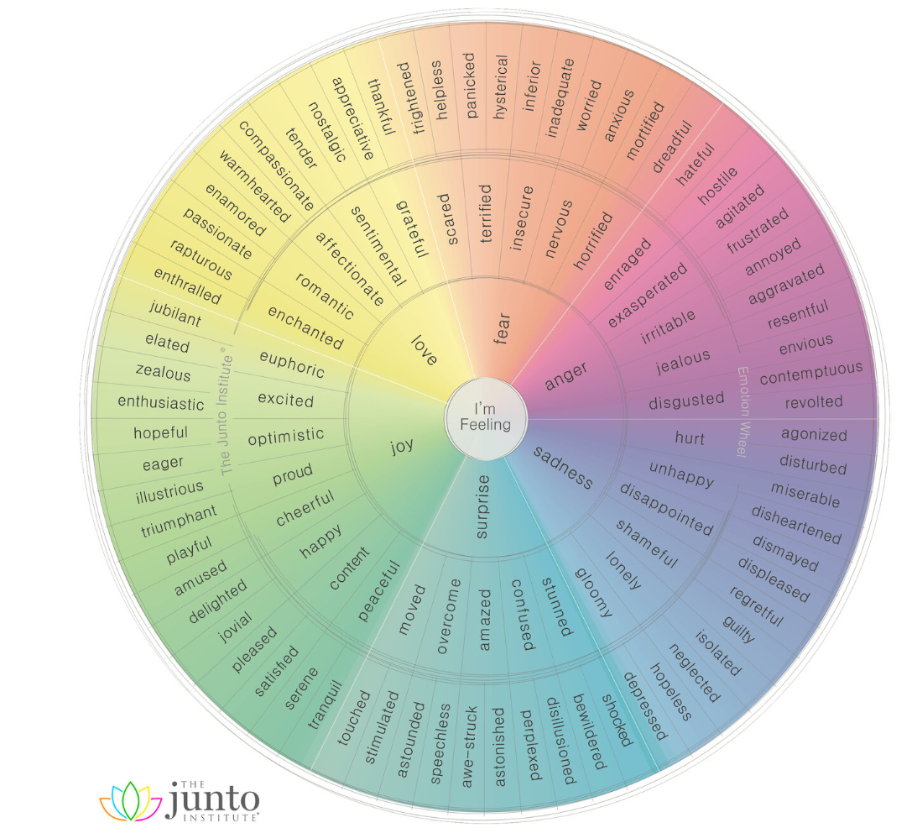
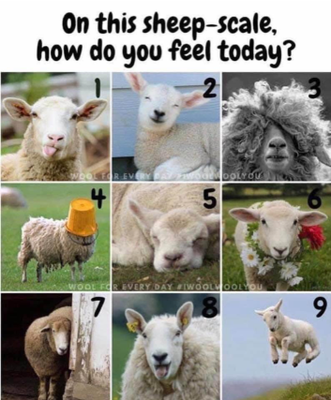
Notes:
Another conversation starter to explore how someone is feeling and why, what support is needed if any?
This Junto wheel identifies 6 primary emotions which then extends out to degreed versions of those primary emotions, so if an individual says they feel sad is it that they feel hurt, unhappy, isolated, miserable etc
This tool can help to open up discussions on feelings that can identify and verbalise complex emotions which sometimes we have to name it to tame it.

Slide 4
Are you a River or a Rock?
Notes:
Another tool for reflective thought around change and uncertainty conversations
Ask the individual to reflect on whether they tend to go with the flow and see where it takes them and see where they end up …
Or are they more of a rock that stays grounded until they have more information before moving forward ?
What support/information is needed to move forward or step back a little?
Reflect on the team as a whole, how many rocks, how many rivers are in your team? Any impact?
Can the rivers support the rocks?

Slide 5
Where do you rate your own personal resilience?
Notes:
These tree related pictures can invite an individual to think about and rate their own personal resilience
Share that George Vaillant- a psychologist and professor at Harvard University quoted “A resilient individual resembles a twig with a fresh green living core, when twisted out of shape it bends , but doesn’t break, but instead springs back and continues to grow”. - Rather describing that most people do and will recover from difficult situations and experiences
All the images are open to interpretation, depending on what resilience means to each individual.

Slide 6
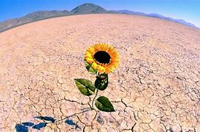
Micro renewals
Small actions used frequently
Built into our every day
Prevent build up of stress and burnout
Allows us to remain mentally and physically healthy and resilient
What are your micro renewals?
Notes:
A tool to support resilience and wellbeing conversations
Micro-renewals are small actions that we can use frequently and build into our every-day working to prevent stress and burnout that becomes detrimental to our well-being. EG: Taking regular breaks, going for short walks, walking the dog, getting some fresh air for 10 minutes etc
Explore what they do if anything to renew/recharge and identify any support needed to ensure the individual/team are renewing regularly.
What is it that helps them through a tough day? What helps them through any day?
Quite often people save their renewal time for when they take annual leave or have to go off sick because they’ve already hit burnout.
But if we do this, we often spend our annual leave poorly and unable to enjoy it as we wanted to because we are having to use our energy to
renew from a much worse place than is ideal. Renewing regularly benefits everyone, self, family, colleagues, team

Slide 7
Fact: you are human
Notes:
A change and uncertainty conversation starter to explore where individuals are on the transition curve
Where are you on the curve? Identify any support needed to move along the curve? Explore any consequences of not moving along the curve?
Key points;
It is okay and natural to be anywhere on the curve, we are all individual.
You may be at different places on the curve in the same day depending on the situation, conversation, person
People can move backwards and forwards along the curve

Slide 8
Circle of Influence
Notes:
This tool can be used to explore concerns that we either need to accept (out of our control) identify those we can influence and which ones we can focus our energy on (the things we can control)
Invite the individual to draw the 3 circles and place their concerns in each of the circles where they can either accept, influence or control them
Accept - the concerns outside of your control and influence. Try to let these go and focus on what you can influence and control.
Influence - the concerns you can influence. So, for example you might not be able to control changes happening in your organisation, but you may be able to influence them through the actions you take. How can they be more proactive in this area?
Control - the concerns/elements that you can control. Focusing on this area will minimise feelings of being overwhelmed and frustration.
These include behaviours, actions, attitude, outlook and decisions.
See an example on next slide to share

Slide 9
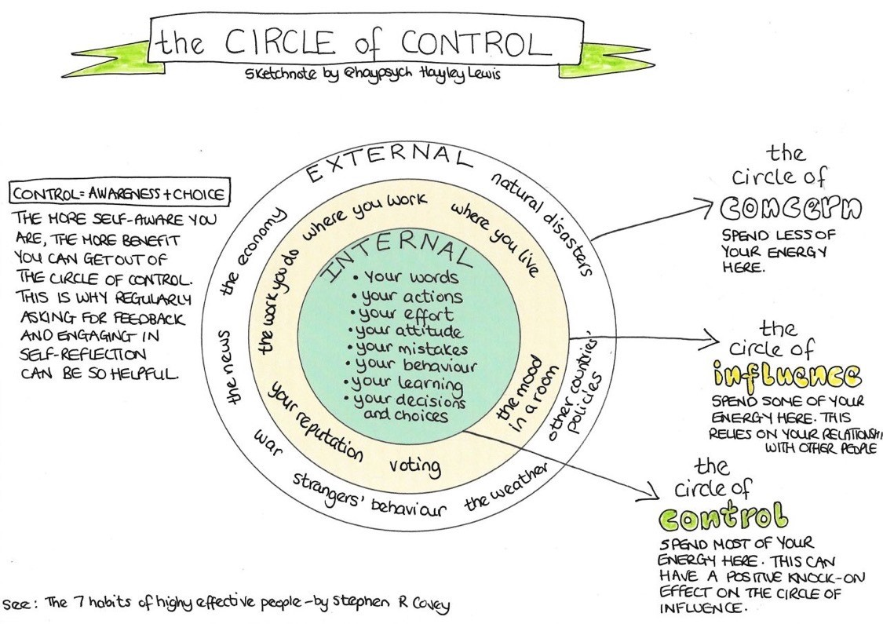
Notes:
“If we spend a lot of our energy worrying about things we can’t control, we end up feeling powerless and overwhelmed. The sweet spot is where we focus our energy on the areas we can control…”

Slide 10
Links to further support Organisational Development (sharepoint.com) Wellbeing-looking after you and your colleagues (sharepoint.com)
Notes:
Click on links or signpost individuals to explore/access further support, encourage learning and development

Slide 11
Other Resources
The Blob Tree
Stress container
Notes:
Click on the links to download
Can be used for all discussions in relation to change, uncertainty, wellbeing and resilience

