Slide 1
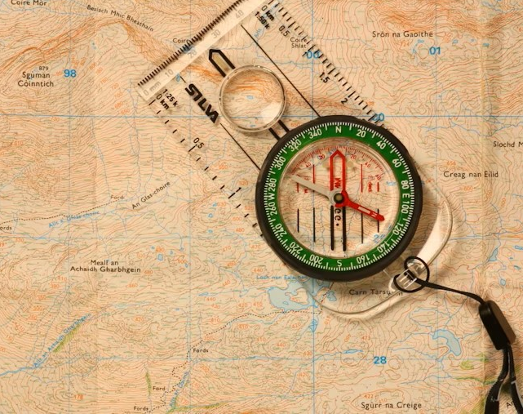
Navigating hormone journeys
Dr Catherine Munro
GP Kendal
BMS Advanced Menopause Specialist and Trainer

Slide 2
Your Questions
Can I ever have HRT after breast cancer? – and can I restart after age 60?
Bones – been on calcium tablets but came off for a rest. Do I need if I am doing lots of weights and strength exercise?
Could I be perimenopausal in my 30’s?
Could I take HRT even though still having periods?
Can I pregnant in perimenopause?
In my 50’s - Do I need to come off HRT when I am through menopause even though still having symptoms?
Does PMDD get worse in perimenopause?
HRT synthetic vs natural?
Do doctors tend to assume anxiety rather than menopause?
What happens if you take HRT too early? Are there adverse effects to doing this?
Does mirena impact on menopause as you don’t get periods?

Slide 3
I can’t sleep..
Ignored
Felt brushed aside
I don’t know myself
Going Mad!
I feel 2D
Time to stop HRT?
Too young for menopause?

Slide 4
What I hear…..from doctors
Too young for menopause
HRT is too much of a risk
Have as much oestrogen as you want/need…
Brain fog isn’t a thing
It’s all about iron
It’s all about sleep
Hormones are the solution
Hormones are the enemy

Slide 5
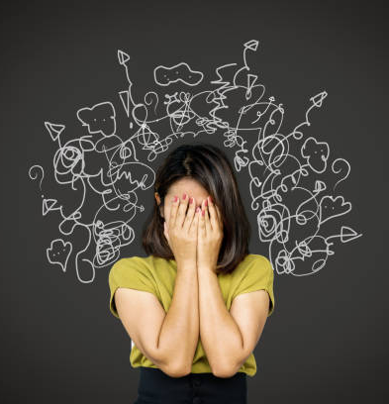
And social media ?!
Eat 30+ fruit and veg
Avoid UPF’s
Take magnesium
Take collagen
Take testosterone
Cold water swim
Warm water soak
Spend a fortune on supplements

Slide 6
Panorama

Slide 7
Back to basics
Puberty
Periods (300-400 in average woman’s lifetime)
Perimenopause
Menopause
Early and Premature menopause
Bumpy roads…PMS / PMDD / Endometriosis / Heavy periods
Abrupt journey ends…surgical and iatrogenic menopause

Slide 8
Could it be menopause?
Menopause occurs under 40 in 1:100 women and under 30 in 1:1000
Perimenopause lasts 5-7 years on average
…no one is too young to experience menopausal symptoms
After menopause: increased risk cardiovascular disease; increased bone loss; increased cognitive decline; increased urinary and vulvovaginal symptoms; reduced libido
Earlier menopause increases risks
Menopause is not a disease, but its impacts can be considerable for many women

Slide 10
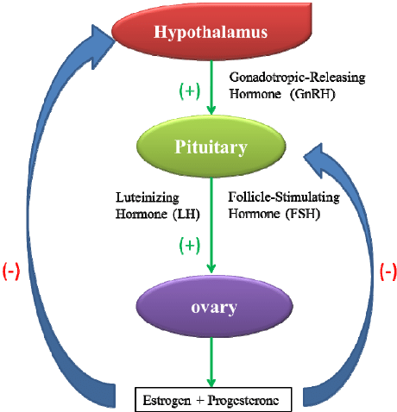
‘Normal’ menstrual cycle

Slide 11
What are our hormones doing?

Slide 12
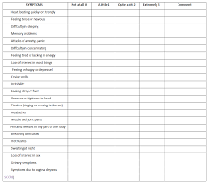
How I make a diagnosis… collaboration between doctor and patient
Period changes
Please track your cycle
Symptoms
Please track your symptoms
Blood tests
Primarily help to rule out other causes
Eg thyroid abnormality, anaemia, other causes
Sex hormone tests can help differentiate:
Hypothalamic amenorrhoea/POI
FSH not needed or helpful >45

Slide 13
What to look out for…

Slide 14
Hot flushes/night sweats are where the evidence lies

Slide 15
A framework to approaching hormones…
Symptoms
Impacts
Priorities
Actions

Slide 16
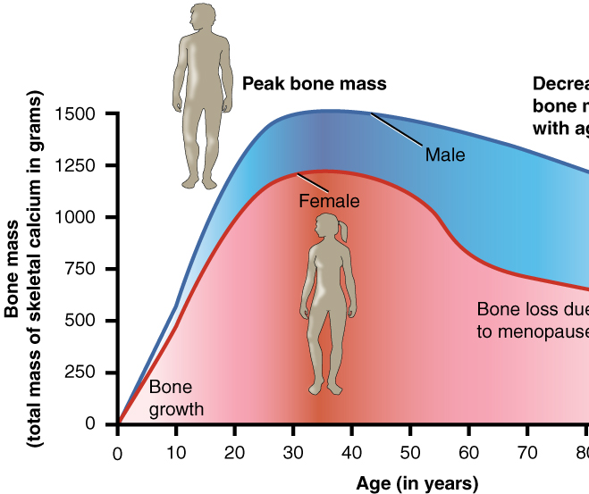
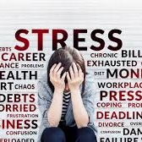
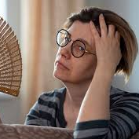
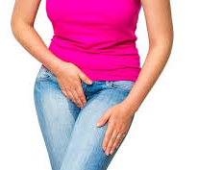
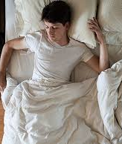
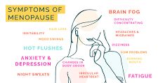
Impacts
Mental health
Relationships
Ability to Work
Ability to function outside work

Slide 17
General impact of hormones…
Up to 90% of women experience premenstrual symptoms
20-40% experience PMS, with 2-8% experience PMDD (severe PMS)
80% of women experience period pain at some stage
10% of women experience heavy periods
10% of women experience postnatal depression
Around 80% of women experience symptoms of menopause

Slide 18
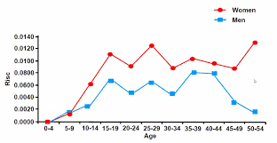
Menopause, mental health and employment
16-fold increase in depression in women aged 45-52
7-fold increase in suicide in women aged 40-50
59% women taken time off due to symptoms of menopause
18% >8 weeks sick leave
50% taking >8 weeks off then retired or took early retirement

Slide 19
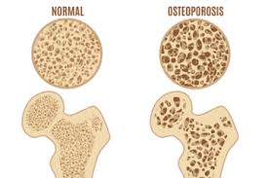
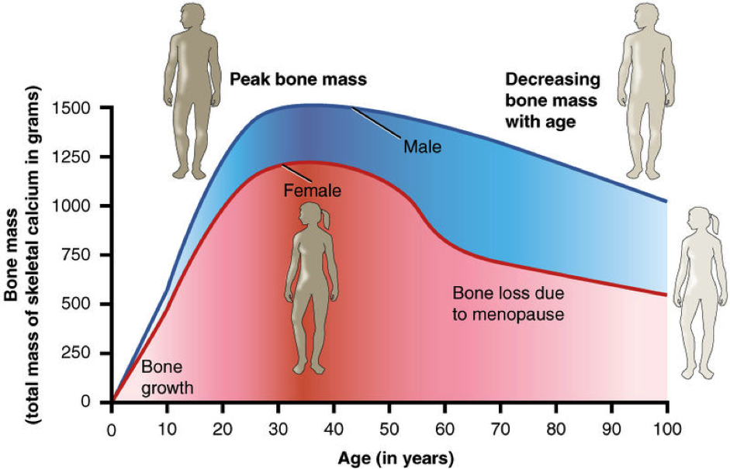
Impact of hormone changes on bone health
Hip fracture in women more common than breast/uterine/ovarian cancer combined
1:2 women and 1:5 men will get osteoporosis
25% drop in bone density in 10 years around perimenopause
Bone is a live organ and renews every 10 years…what we do influences our bone health
It’s never too late to improve your bone strength

Slide 20
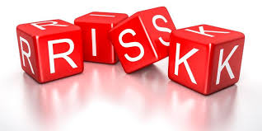
Risk factors…
Low body weight (BMI<18), especially if has affected periods in past
Family history
Ethnicity – more in white and Asian women
Diet
Inactivity
Smoking
High alcohol intake
Lack of vitamin D

Slide 21
Bones…what to do
Check your bone health:
FRAXPLUS.org
Diet:
enough calcium – best through diet
Enough vitamin D
Adequate protein
Enough carbohydrate
Exercise:
weight bearing
AND strength building

Slide 22
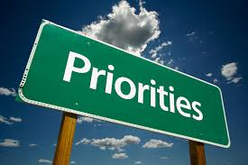
Priorities
Individualised approaches work best
What is most impactful on me?
What will help me live/work/enjoy life better?
If I solve ‘x’, life will be better
…where ‘x’= concentration or energy or pain or anxiety or mood swings or urinary symptoms or vulval soreness etc etc

Slide 23
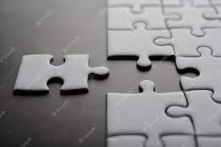
What do I need?
Life ‘stuff’
Exercise – …can help massively
Nutrition
Mindfulness and relaxation
Hormone replacement therapy*
Non hormonal options
Herbal options and supplements

Slide 24
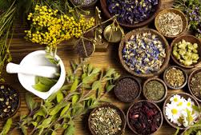
Herbal remedies
Black cohosh
Red clover
Ashwaganda
Sage
St Johns Wort
Starflower oil – breast pain
Magnesium – sleep/cramp
Collagen
Always worth bearing in mind that non prescribed treatments and interfere with medications – PLEASE CHECK

Slide 25
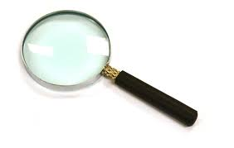
Non hormonal options
Symptom focus
Mood/sweats: antidepressants
Sleep: CbT
Sweats: clonidine / fezolinetant
Aches and pains: painkillers / chronic pain medications

Slide 26
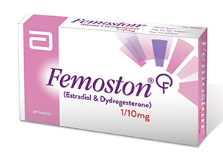
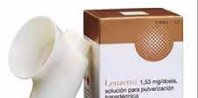
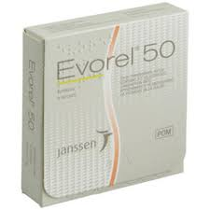
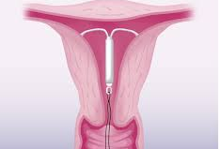
HRT
Oestrogen – symptom relief AND some long-term health benefits:
Tablets
Patches/ gel / spray
Progesterone – protects the womb lining (and often helps with some symptoms)
Body identical progesterone – utrogestan
Progesterone coil – mirena –for most people, doesn’t suppress ovulation – just stops bleeding; cycle remains but symptoms can be easier
Synthetic progestogens – in tablets and combined patch
Progesterones can be taken cyclically in perimenopause – but aim to go to continuous dose after a 2 years
Drosperinone (Slynd)
Evidence of benefit for body identical rather than BIO-IDENTICAL hormones
Synthetic vs natural – depends what you mean…
IF YOU HAVE A WOMB, YOU NEED PROGESTERONE !!!
AND at the right dose!

Slide 27
Endometrial cancer and hyperplasia
Oestrogen needs to be balanced by progesterone at an appropriate dose
High dose oestrogen needs a higher dose of progesterone
Aim is to avoid thickening of the womb lining and endometrial cancer
We need to take this stuff seriously!

Slide 28
Benefits of HRT
Main intention is always symptom relief
Starting ‘too early’?
Transdermal oestrogen safe
If levels low, will relieve symptoms
No harm in trying to see if beneficial and then stopping
ALSO…
bone protection
reduced cardiovascular risk (if started <60 or within 10 years of menopause)
reduced risk endometrial cancer if taken correctly
reduced risk bowel cancer
possible benefit in dementia – the jury is out

Slide 29
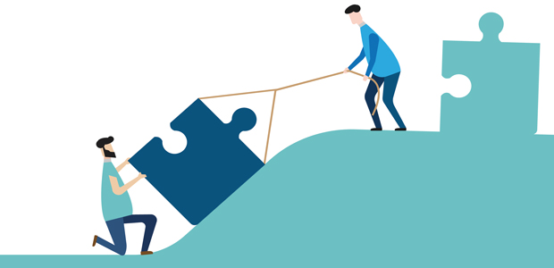
’You can’t have HRT because…’
Breast cancer in family
Personal history breast cancer
Other cancers
Migraine
Epilepsy
Cardiovascular conditions
DVT’s

Slide 30
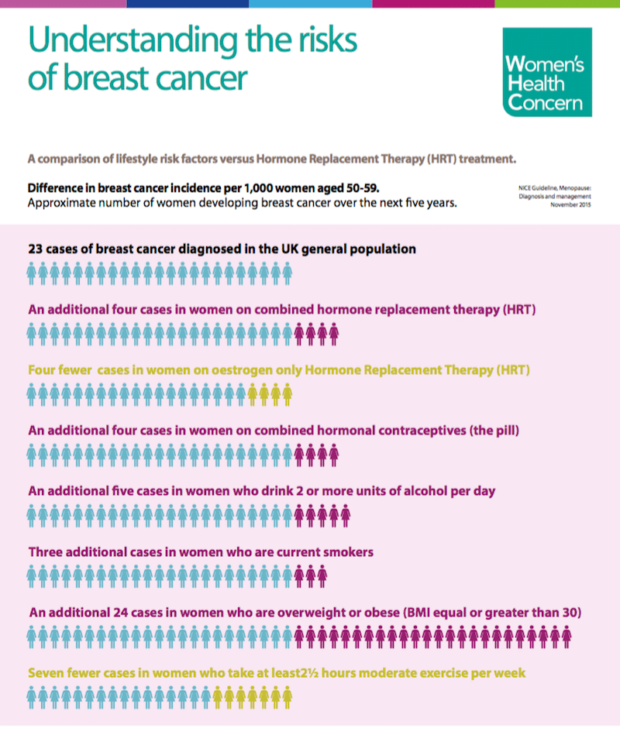
Understanding risks
Breast Cancer:
HRT does NOT change a normal breast cell into a cancerous one
HRT CAN increase the growth of existing cancer cells
Breast cancer risk is dependent on the type of progesterone
IF develop breast cancer, it may be caught earlier and is not associated with increased mortality

Slide 31
Testosterone
BMS Guidance says that testosterone is for ‘Hyposexual Desire Disorder’ – diagnosed with HSDD Questionnaire
Testosterone may also help with other symptoms (evidence limited)
Energy
Mood
Muscle and joint aches
If no relief after 6 months, stop

Slide 32
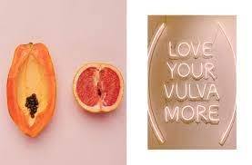
Vulval and vaginal symptoms
Not an inevitable consequence of ageing and child-bearing
Protect your pelvic floor
Almost every woman will benefit from vaginal oestrogen
AND vaginal moisturisers
TREAT YOUR VAGINA LIKE YOU TREAT YOUR FACE ☺

Slide 33
Take home messages
Hormonal changes occur gradually in most people
Track periods and symptoms
Lifestyle is important
HRT can help in many cases
There are other options
Good quality, science backed evidence is key
Find the right approach for you

Slide 34
Catherine.munro7@nhs.net
ROS.org.uk
Menopausematters.co.uk
Balance-menopause.com
BMS.org.uk

