Slide 1

Fire Protection – Out of Hours

Slide 2
Agenda
Scope
Objectives of the Review
Current System
Proposed System
Key Changes
Timeline and Stages of the Process
Employee Support and Advice
Next Steps

Slide 3
Review Scope
To provide Cumbria Fire & Rescue Service a Fire Protection Out of Hour response with an operational response to provide a Building Tactical Advisor role.

Slide 4
The objectives of the review
What are the objectives of the change
To provide an OOH Fire Protection system that is effective, suitable and sustainable.
Commence a 12-month trial with 4 members of the Greybook workforce.
Provide technical fire safety advice to operational crews where it is required
Attend incident where there is a fire safety issues that could/does result in an article 31 prohibition notice being issued.
Respond on a blue light response to an incident of a certain building/incident type to provide tactical building advice to the incident commander to help with their decision making on matters such as fire engineering solutions, fire suppression systems, compartmentation, evacuation strategies and any previous fire safety audit information.

Slide 5
The current position
The current OOH provision is not fit for purpose.
It was being undertaken by four corporate members of staff who self-roster onto the rota.
This was being paid at £15 per shift
Due to it be a self-rostered system there are times where the rota is not covered.
That it currently operates with 2 members of staff and remove the fact that they have left the service

Slide 6
What’s involved
The proposal of a 12 month trial being ran that will involve 4 members of the fire protection grey book staff undertaking this duty system on a voluntary basis
This will be for a pay enhancement of 10% of their current salary band.
The role of the fire protection out of hours officer will be expected to provide advice to crews regarding fire safety, attend premises where crews believe fire safety breaches occur to issue article 31 prohibition notices.
The role of the Fire protection out of hours officer will also be attached to PDA’s of certain premises and incident types within Cumbria to provide a blue light response to be a building tactical advisor where they will provide advice to the incident commander to help with their decision making on matters such as fire engineering solutions, fire suppression systems, compartmentation, evacuation strategies and any previous fire safety audit information.
Turnout will come via pager and or mobile phone and requests from crews will come via mobile phone. There will be a vehicle made available for the fire protection out of hours officer to use whilst they are on duty.
To ensure that all members of staff are meeting the NFCC competency framework the service will look to put all staff who undertake this onto a course which covers NOS FS5.
They will also have to attend a blue light course for driving a car under blue light conditions.

Slide 7
What engagement means to you?
1 month engagement period
Staff meetings / engagement:
  First - Wednesday 11th December 2024 at Kemplay Bank, Penrith HQ
  Mid - mid-point reviews w/c 6th January 2025
  Final - w/c 13th Jan engagement closes
Individual meetings 1:1 if requested
Group meetings can be arranged
Review and decision between w/c13th January 2025 and w/c 20th January 2025
w/c 20th January 2025 – final decision with TU’s
w/c 27th January 2025 – Final decision with staff communicated

Slide 8
Review and Decision
We will aim to notify all in scope employees of the outcome within 2 weeks of the engagement process ending. This will be accompanied by an outline timetable for the process.
Should there be a need to extend the 2 week decision period as a result of significant issues raised, then all staff will be notified as early as possible, with an explanation for why an extension is required.

Slide 9
Next Steps
Over the next 12 months we will gather feedback.
The Statement of Change, Presentation, and FAQ’s will all be made available on Sharepoint.
We will regularly update the FAQ’s.
The engagement window is your opportunity to put forward your opinions and suggestions for the new working arrangements.
All feedback will be considered.

Slide 10
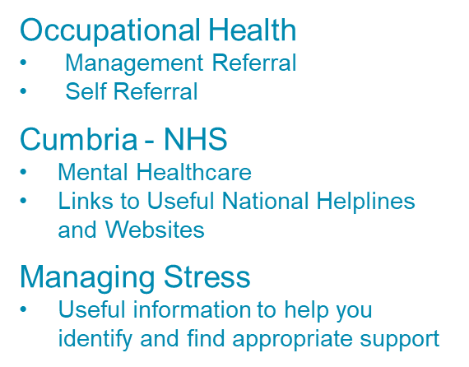



Support and Advice
CFRS Human Resources HR@cumbriafire.gov.uk

Slide 11
Discussion & Questions?

