Slide 1

Fire Protection – Out of Hours

Slide 2
Agenda
Scope
Objectives of the Review
Current System
Proposed System
Key Changes
Timeline and Stages of the Process
Employee Support and Advice
Next Steps

Slide 3
Review Scope
A change to the out of hours duty system to create a recall to duty system policy.
Corporate members of the fire protection team will be given a payment to go onto the list to receive calls for fire protection advice and potentially serve prohibitions. Any calls and attendances will be paid at the hourly rate for corporate personnel.

Slide 4
The objectives of the review
To provide an OOH Fire Protection system that is effective, suitable and sustainable.
To use the premium payment within the for corporate staff to pay a payment of £1000 to put individuals on a recall to duty list. This will be split over a 12-month period.
To put a contract addendum in place for current personnel that agree to go onto the out of hours list.
Provide technical fire safety advice to operational crews where it is required
Attend incidents where there is a fire safety issues that could/does result in an article 31 prohibition notice being issued.
For new employees to be recruited with the expectation they go onto the system when they are competent.

Slide 5
The current position
The current system is being undertaken by four corporate members of staff who self-roster onto the rota.
This was being paid at £15 per shift.
Two of the individuals have left the service and the model cannot be relied on by two individuals.
Due to it be a self-rostered system there are times where the rota is not covered.
The current terms and conditions doesn’t include an appropriate way of paying corporate members of staff for completing work outside their current working arrangements.

Slide 6
Previous considerations
A 10% enhancement for operational inspectors on their salary for 4 members of staff.
Work a rota system that ensure one person was on duty at any one time, to provide 100% cover for 24hrs a day, 7 days a week and 365 days a year.
They would provide Fire safety advice and issue prohibition notices where required.
They would provide a blue light operational response to certain predetermined attendances and provide tactical building knowledge as a tactical advisor. They were also available to be used for larger incidents.

Slide 7
Corporate staff system proposal
A voluntary system for people to sign up to.
A premium payment of £1000 for members of the fire protection team to go onto a recall to duty type list. Spread over a 12-month period.
If there is a need for OOH fire protection assistance, then the duty GM will use that list to contact on of the team to either provide advice over the phone or attend in person.
If you are available and can deal with the request and if you aren’t available then you can decline it, the GM will then go to the next person on the list. If an individual agrees to take the call and picks up the work, they will go to the bottom of the list.
Payment for this will be inline with the call out provision of the pay and benefits booklet – This is the hourly rate for inspector with a minimum of 2 hours then an hourly rate after the 2-hour period.
If an individual is unable to attend 3 times in a three-month period, then a conversation will be had with their line manager, with the possibility of being removed from the list.

Slide 8
What engagement means to you
6-week engagement period
Staff meetings / engagement:
First - Wednesday 14th January 2026
Second - mid-point reviews w/c 09th February 2026
Final - w/c 23th February 2026 engagement closes
Individual meetings 1:1 if requested
Group meetings can be arranged
Review and decision between w/c 02nd March 2026
w/c 02nd March 2026– final decision with TU’s
w/c 02th March 2026 – Final decision with staff communicated

Slide 9
Review and Decision
We will aim to notify all in scope employees of the outcome within 2 weeks of the engagement process ending. This will be accompanied by an outline timetable for the go-live.
Should there be a need to extend the 2-week decision period as a result of significant issues raised, then all staff will be notified as early as possible, with an explanation for why an extension is required.

Slide 10
Next Steps
The Statement of Change, Presentation, and FAQ’s will all be made available on Sharepoint.
We will regularly update the FAQ’s.
The engagement window is your opportunity to put forward your opinions and suggestions for the new working arrangements.
All feedback will be considered.

Slide 11
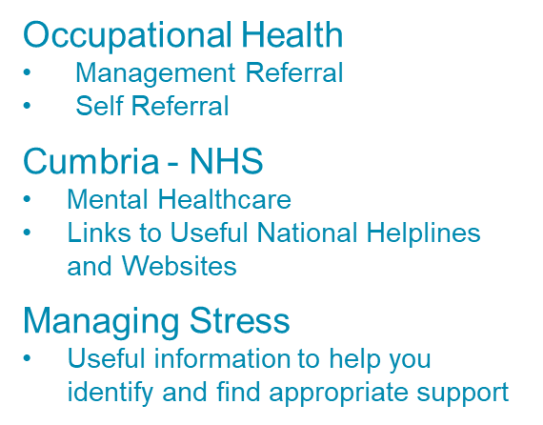
Support and Advice
CFRS Human Resources HR@cumbriafire.gov.uk

Slide 12
Discussion & Questions?

