Slide 1

Staff engagement briefing
Protection
29.4.26

Slide 2
Agenda
Service position and restructure objectives
Current Structure
Service Delivery Proposal
Proposed Structure
Key Changes
Timeline and Stages of the Process
Employee Support and Advice
Next Steps & Key Dates

Slide 3
Service Position and Restructure Objectives
The aims of the restructure are to:
Improve departmental capacity and resilience
Increase professional fire safety knowledge and qualifications across the Service
Align with national standards and CRMP objectives
Embed Fire Investigation (FI) within Protection to strengthen governance and assurance
Improve evidence led ability to target risk
Notes:
The 2023-25 HMICFRS report for Cumbria Fire and Rescue Service (CFRS) identified that 95 high-risk premises audits were carried over from the 2021-24 RBIP and recommended that ‘the Service should complete all audits within the RBIP schedule’; as of March 2026, the Service is 10% behind on year 1 RBIP targets, highlighting a structural capacity issue.
Grenfell Tower Inquiry (GTI) Phase 2 recommendations (113.26 and 113.28) emphasise the need for enhanced fire safety competence among fire safety professionals and first responders to ensure they are equipped to handle emergencies effectively.
FI currently sits across individual FDOs rather than within a structured department, leaving the function without dedicated oversight, governance or budget, no centralised Continuous Professional Development (CPD), training pathways or quality assurance, and no accountability. This creates organisational vulnerability and limits CFRS’s ability to meet the FI Fire Standard (FS) requirements.
Recent reports from IRS show that many operational staff do not have the basic fire investigation skills to determine causation following a fire. Figures from 2024/25 show that the causation outcome of 20% of all primary fires was recorded as unknown; when looking at commercial fires this figure rose to 40%. This significantly limits our ability to target Prevention and Protection campaigns, support accurate Community Risk Management Plan (CRMP) development or target emerging risk.
CFRS FI Policy requires that L1 commanders carrying out Tier 1 FI following a fire call should be trained and competent to a level equivalent to L2 FI, this is not currently being achieved.
The CRMP 2024-28 commits CFRS to embedding FI within the Protection department, directly linking this restructure to corporate and strategic priorities.

Slide 4
Review Scope
Post Title | Post Grade | Number of Posts | FTE
Total (excluding on-costs) Total (with on-costs)
Post Title | Post Grade | Number of Posts | FTE
Total (excluding on-costs) Total (with on-costs)

Slide 5
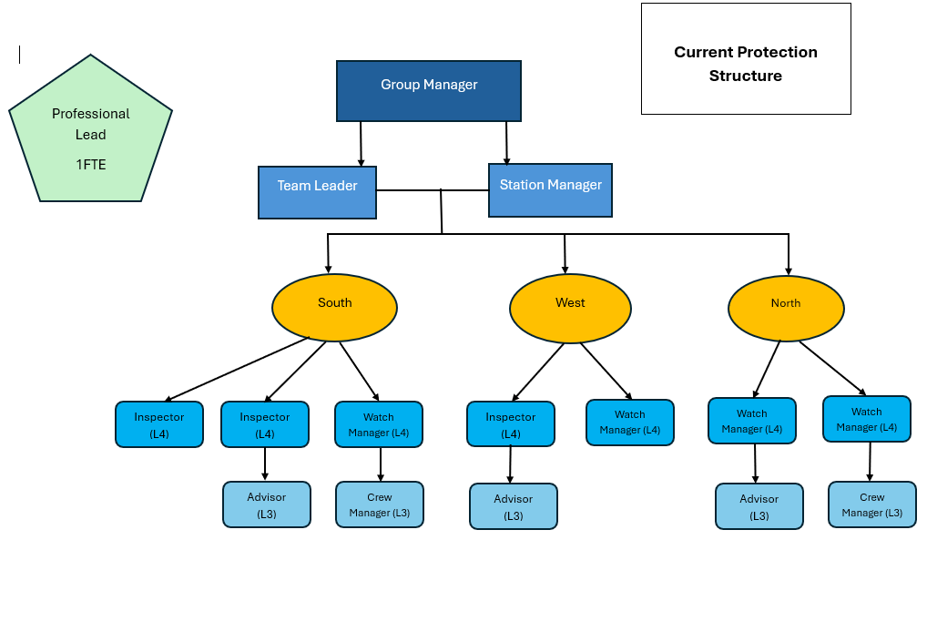
Current Structure

Slide 6
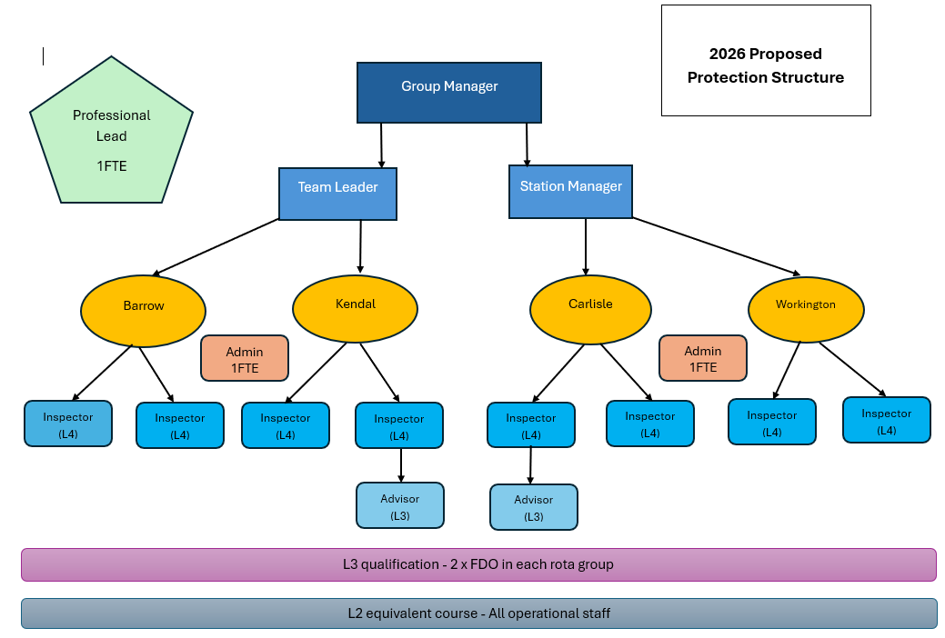
Proposed Structure
Notes:
The proposed Protection structure (Appendix 2) relocates capacity to 4 base locations (Carlisle, Kendal, Workington and Barrow) with 2 x L4 qualified staff at each location, with 2 x L3 advisors level and 2 x business support administrators (BSA) supporting the whole service. The structure will be made up from 2 x WM, 6 x Inspectors, 1 x temporary CM, 1 x Advisor and 2 x BSA.
Each WT watch will have a designated PoC from amongst the Inspectors which will enhance working relationships with the watches.
Benefits:
£8,592 annual wage savings (Appendix 3), with the temporary CM costs funded through the Protection Uplift Grant
Increased RBIP capacity and resilience; 2376 audits over the 3-year period versus 2088 currently (Appendix 4)
Improved statutory consultation capacity, Protection mailbox management and increased workplace quality assurance
Enhanced proactive and reactive business engagement, including in non-wholetime areas of Cumbria, supporting the Protection FS and CFRS’s revised Business Engagement Policy (Appendix 5)
Mitigation of corporate risk OPS1/26 (Insufficient Operational Resilience at Barrow) through improved ability to manage built environment risk with localised L4 qualified Inspectors
Reduced administrative burden on qualified inspectors, increasing time for audits and enforcement activity.
The restructure includes the introduction of a L3 fire safety qualification for 2 x FDOs for each rota group aimed at enhancing operational performance, reducing risk to firefighters and supporting cross departmental working with both Prevention and Protection functions.
FDOs will be better able to support the Protection department through accurate identification of non-compliance in regulated premises and out of hours support with fire safety complaints and enforcement activities.

Slide 7
Departmental Delivery Staffing Proposal
Post Title | Post Grade | Number of Posts | FTE

Slide 8
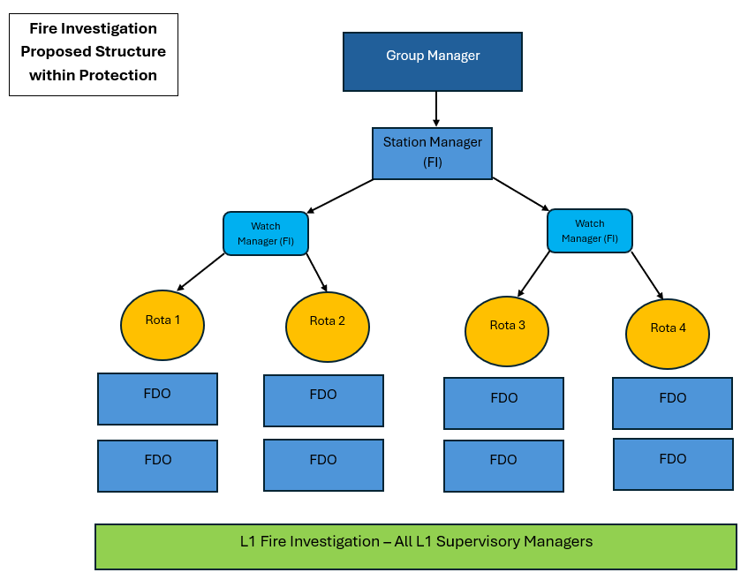
Proposed FI Structure
Notes:
The proposed model (Appendix 6) includes the Protection SM assuming Technical Manager responsibilities, 2 Protection WMs acting as dual role Protection inspectors and primary fire investigators and continued use of trained FDOS fire investigators for resilience and out of hours cover.
Each Protection WM will become the point of contact for 2 rota groups’ investigators, this is to provide oversight and standardisation of investigations, training and CPD across the organisation.
All L1 commanders will receive FI training to L2 equivalent standard, ensuring that data as to origin, cause and development of fire is captured correctly through IRS, enabling accurate trend analysis.
Benefits:
Centralised governance and improved organisational assurance
Strengthened relationships and collaboration opportunities with key legal and forensic partners, including Police forensic units and coroners
Standardised training, processes, quality assurance and CPD
Improved organisational risk management through better use of FI data to inform strategic risk modelling and CRMP development
Direct links between investigation outcomes and operational learning that reduces future fires through better informed Prevention and Protection activity
Feeding learning into incident command training and operational policy supporting firefighter and public safety
Reduced organisational risk to challenge within the Judicial or Coronial court environment due to improved competency and evidence standards

Slide 9
Key Changes
If agreed following consultation, this would result in:
Creation of:
3 more Inspector posts
2 Protection Team Coordinator posts
Base location responsibilities
Removal of:
2 WM posts (1 WM redeployed)
2 Advisor posts
1 temporary CM
Change in role responsibilities for 2 WM posts

Slide 10
Timeline and Stages of the Process
Date | Activity
14th April 2026 | Decision paper to SLT
29th April 2026 | Initial Protection team consultation
14th May 2026 | Mid point meeting
29th May 2026 | Consultation Ends
w/c 1st June 2026 | Collation and review of feedback
4th June 2026 | End point meeting

Slide 11
What engagement means for you?
30 day engagement period 29th April to 29th May 2026
Staff Meetings:
Opportunity of 1:1s with management on request
    Request a 1:1 via your line manager
    Group meetings can also be arranged
What support is available?
Meeting | Date | Venue | Time
First | 29th April | HQ Community Room, Penrith | 14:00
Mid-Point | 14th May | HQ Community Room, Penrith | 10:00
Final | 4th June | HQ Community Room, Penrith | 10:00
Notes:
You will be added to these meeting dates following initial consultation
Support available through:
Line managers, Scott and I also available
HR
Recruitment
Trade union representatives

Slide 12
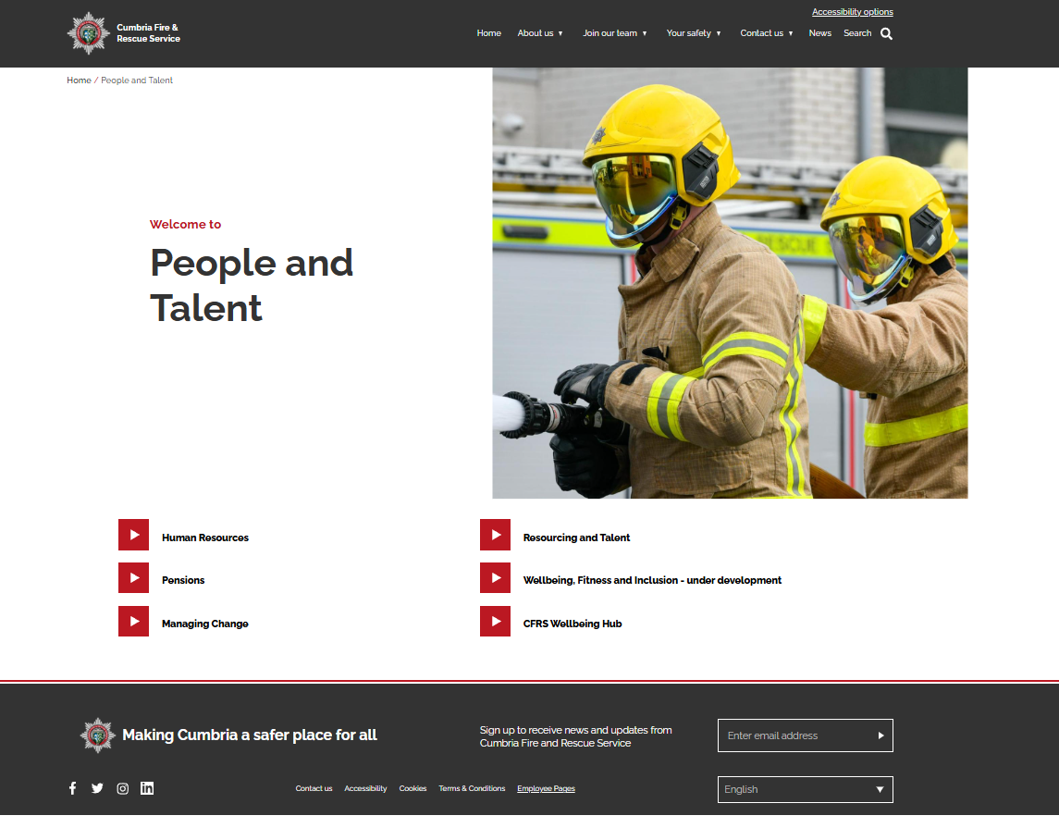
Employee Information Website
People and Talent | Cumbria Fire & Rescue Service

Slide 13
Assimilation Process
Current Structure
Process
New Structure
Positions within the Current Structure
Positions within the New Structure

Slide 14
Assimilation
Assimilation process will compare old and new roles to determine where assimilation appointments can be made
Direct Assimilation
- the job grade/ scale/ range is the same and
- must be a 75% or more match (substantially similar) overall against assimilation criteria
Assessed Assimilation
- the job grade is different
- a further assessment process is required to ensure the job holder has the necessary skills, knowledge and competences to fulfil the requirements of the post
- it is the responsibility of the employee to identify and objectively evidence that a new post is substantially similar (75%), which must be verified by two managers (departmental manager and senior manager)
Competitive Selection
- Following direct and assessed assimilation, where it is identified that there are more people than posts, a competitive selection process will be necessary.

Slide 15
Final Outcomes
Personalised outcome letters issued following 4th June meeting
Any vacancies which have not been filled through Assimilation will be advertised.
For employees who have not secured a post:
  Alternative employment support
  Meetings with the departmental manager and senior manager to discuss other options

Slide 16
Alternative Employment Support
Meetings with departmental manager / senior manager / PO
Alternative Employment Support
Trial period?
Job searching support

Slide 17

Support and Advice
Line Managers
Trade Union Representatives
HR Team
Pensions Advice – LPPA
CFRS website and SharePoint

Slide 18
Coping with change
Occupational Health Service
Management Referral
Self Referral
Cumbria - NHS
Mental Healthcare
Links to Useful National Helplines and Websites
Managing Stress
Useful information to help you identify and find appropriate support

Slide 19
Next Steps
Over the next 30 days we will gather feedback.
The Statement of Change, Presentation, Structures, Post Specifications and FAQs are all available on the Employee Information Website.
We will regularly update the FAQs.
The engagement window is your opportunity to put forward your opinions and suggestions for the new service/team.
All feedback and alternative suggestions will be considered.
Notes:
Feedback can be via 121 meetings, emails, letter, through TU reps

Slide 20
Discussion and Questions?

