Slide 1

On Call Prorate Leave
Trial 2026

Slide 2
History
First trial took place in 2021 which was impacted by COVID-19
January 2025 saw the introduction of new pay bands for on call employees
June 2025 SLT paper was approved to start a new trial due to the new pay bands to make leave equity across all bands.
On call working group meeting in June, Stations volunteered to take part in trial
Following discussions with SDS it was decided to delay the trial to January 2026, the start of a new leave year

Slide 3
History
October 2025, Policy was discussed at JCG.
November 2025, engagement with FBU and FRSA regarding the trial
December 2025, engagement with stations in scope
Jan 2026, trial goes live
March 2026 first quarterly trial review
June 2026 mid-point review
31 December 2026 trial complete

Slide 4
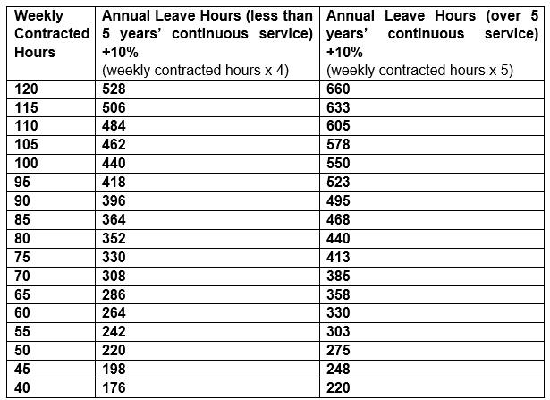
How does it work
Everyone will have
leave will be in hours,
prorate in line with
contracted hours,
plus, enhancement
Notes:
Any variations with contracted hours will be calculated in the same way as the table displays

Slide 5
How to book leave
Requests are made to Line Manager
Line manager will book the leave using the ‘B’ code outside of the individuals 124a contract (yellow bows on gartan)
Only the contracted hours need to be used for leave, if contract for 80hrs and your 124a shows you can give more hours for the week requested you still only use 80hrs, the rest of time will be made up with ‘O’ code.
If the week request is a week when your 124a shows you only give 70hrs you will still use 80hrs leave to balance the weeks over the 124a pattern
Notes:
Example using gartan live after presentation

Slide 6
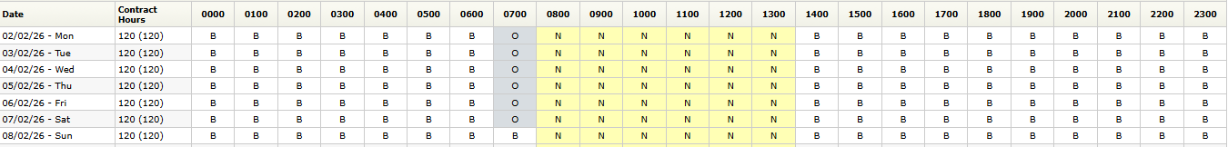
Example 1
Notes:
Meetings will be represented by the LCU manager, Station Wm or agreed representative, TUs, HR

Slide 7
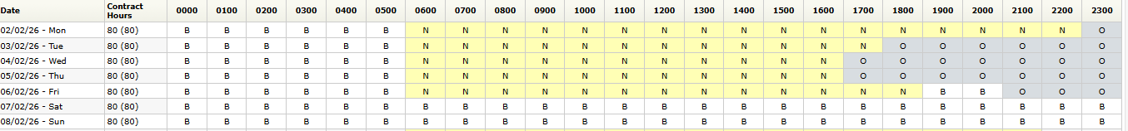
Example 2
Notes:
Meetings will be represented by the LCU manager, Station Wm or agreed representative, TUs, HR

Slide 8
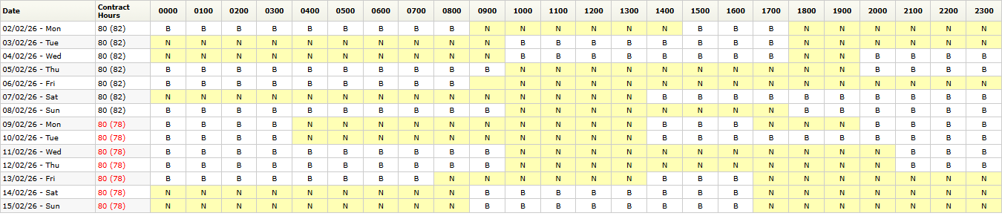
Example 3
Notes:
Meetings will be represented by the LCU manager, Station Wm or agreed representative, TUs, HR

Slide 9
Engagement during the trial
Quarterly review meeting
6 monthly review meeting with a vison to start preparing full implication in 2027 across the service
December 2026 end trial
Notes:
Meetings will be represented by the LCU manager, Station Wm or agreed representative, TUs, HR

Slide 10
Any Questions

